Slide 1
Project-Survival
Producer: Tom
Planner: Rief
Lead Art: Thomas
Lead Dev: Tom
UX: Lucas
Level Designer: Thomas
QA: Arne

Slide 2
Index
Concept
Workflow
Styleguide
Resource Budget
Functional Design
Technical Design
Planning
Organization

Slide 3
Concept
“Story”
Survival Shooter
Wave based

Slide 4
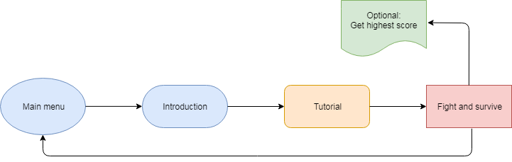
Workflow

Slide 5
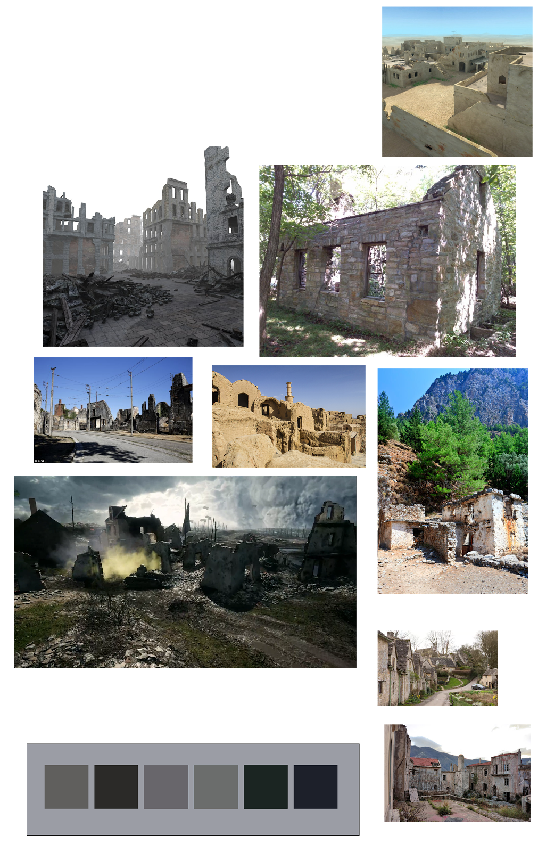
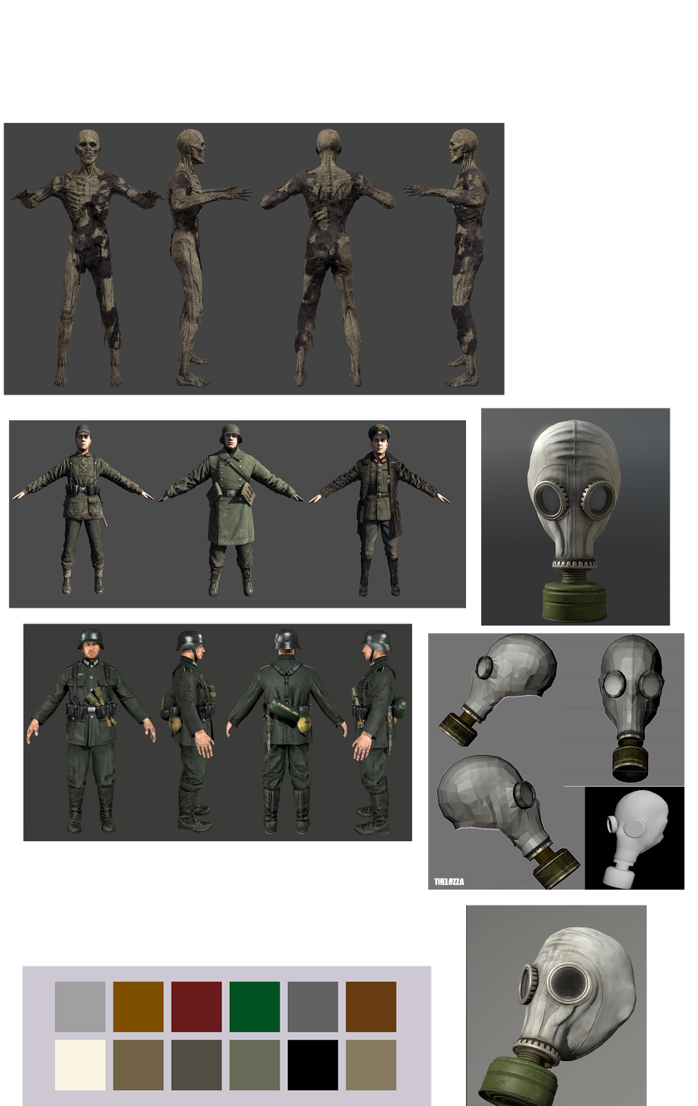
Styleguide

Slide 6
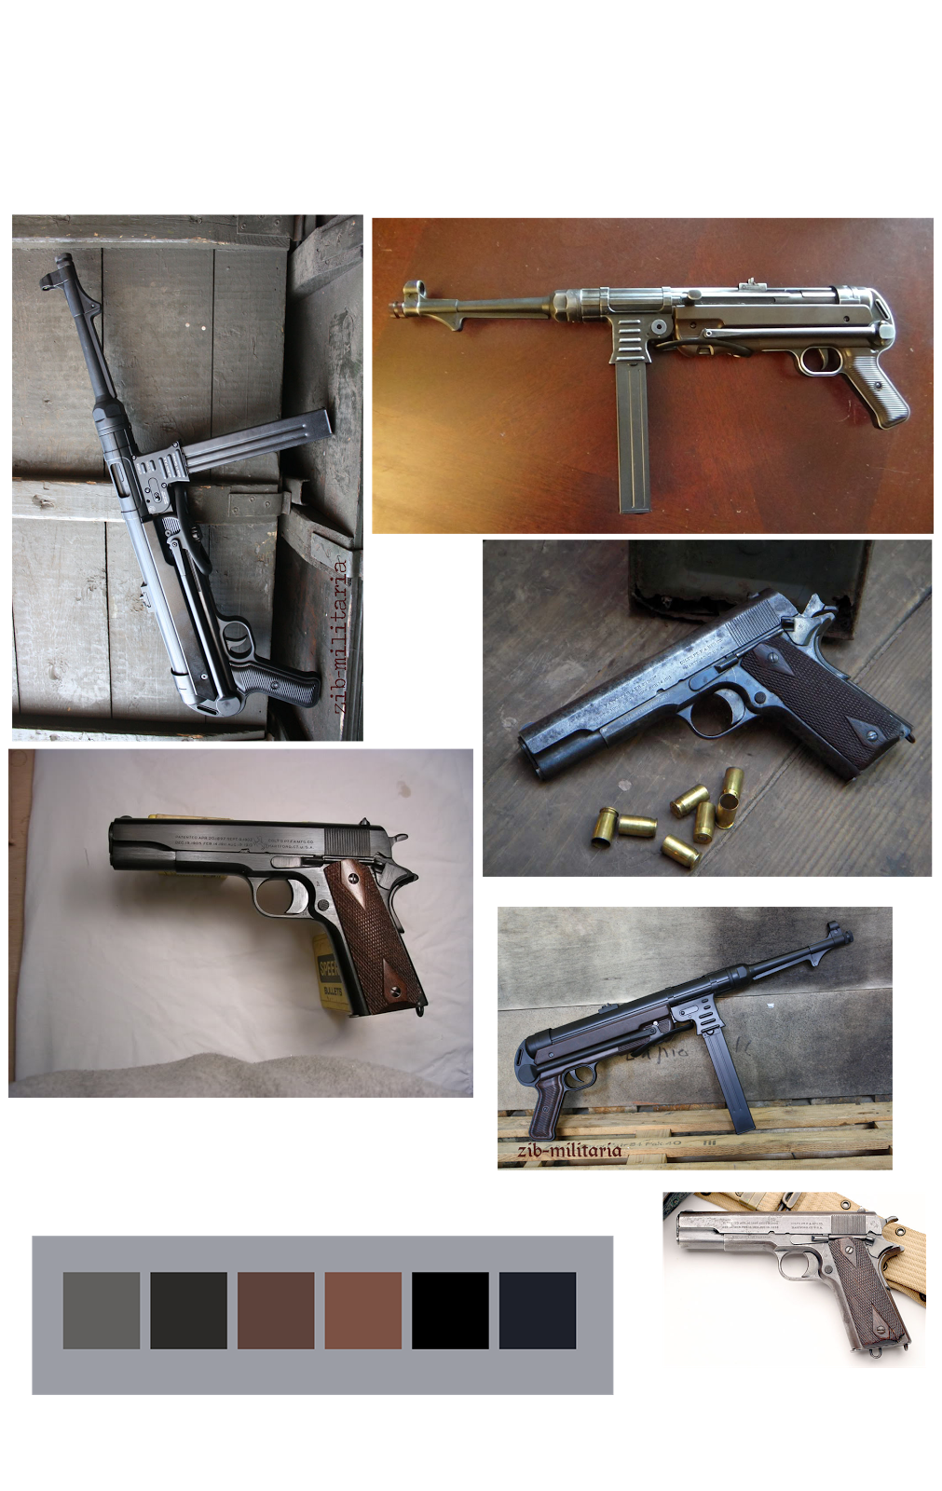
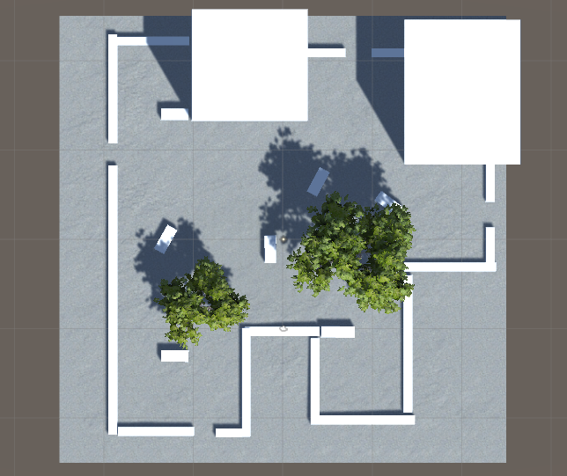

Slide 7
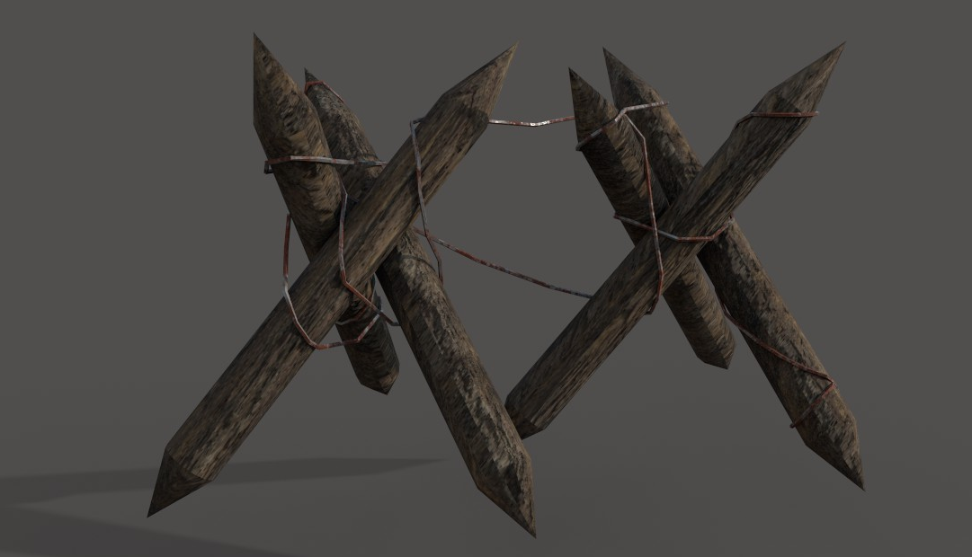
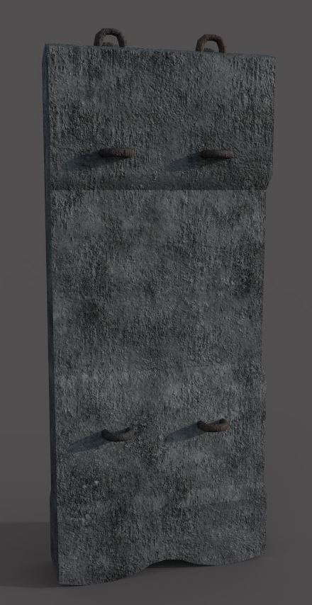
Current Assets

Slide 8
Resource Budget
Polycount
Texture resolution
Environment detail

Slide 9
Functional Design
Camera
Controls
Enemy
Level Design
GUI

Slide 10
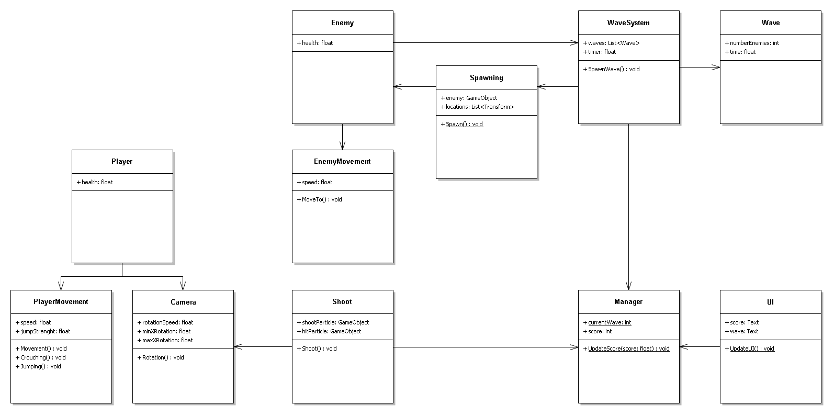
Technical Design

Slide 11
Planning
Trello
Attendance

Slide 12
Organization
Naming conventions
Repository
Sources

